Slide 1
Discrete Mathematics
Functions

Slide 2
Domain and Range of a Relation
The following definitions assume R is a relation from A to B.
Dom(R) = subset of A representing elements of A the make sense for R. This is called the “domain of R.”
Ran(R) = subset of B that lists all second elements of R. This is called the “range of R.”

Slide 3
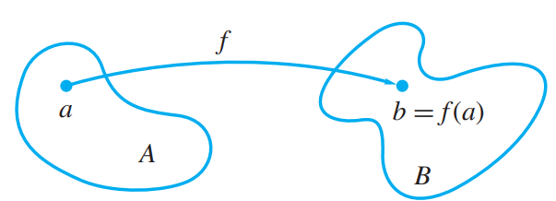
Functions
A function f is a relation from A to B where each element of A that is in the domain of f maps to exactly one element, b, in B
Denoted f(a) = b
If an element a is not in the domain of f, then f(a) = ∅

Slide 4
Functions (continued)
Also called mappings or transformations because they can be viewed as rules that assign each element of A to a single element of B.
Elements of B
Elements of A

Slide 5
Functions (continued)
Since f is a relation, then it is a subset of the Cartesian Product A × B.
Even though there might be multiple sequence pairs that have the same element b, no two sequence pairs may have the same element a.
Example 1 Let A = {1, 2, 3, 4} and B = {a, b, c, d}, and let
f = {(1, a), (2, a), (3, d), (4, c)}.
Here we have
f (1) = a
f (2) = a
f (3) = d
f (4) = c.
Since each set f (n) is a single value, f is a function.

Slide 6
Example 2 Let A = {1, 2, 3} and B = {x, y, z}. Consider the relations
R = {(1, x), (2, x)} and S = {(1, x), (1, y), (2,z), (3, y)}.
S is not a function since S(1) = {x, y}.
The relation R is a function with Dom(R) = {1, 2} and Ran(R) = {x}.

Slide 7
Functions Represented with Formulas
It may be possible to represent a function with a formula
Example: f(x) = x² (mapping from Z to N)
Since a function is a relation which is a subset of the Cartesian product, then it doesn’t need to be represented with a formula.
A function may be a list of sequenced pairs

Slide 8
Functions not Representable with Formulas
Example3: A mapping from one finite set to another
A = {a, b, c, d} and B = {4, 6}
f(a) = {(a, 4), (b, 6), (c, 6), (d, 4)}
Example4: Membership functions
f(a) = {0 if a is even and 1 if a is odd}
A = Z and B = {0,1}

Slide 9
Labeled Digraphs
A labeled digraph is a digraph in which the vertices or the edges or both are labelled with information from a set.
A labeled digraph can be represented with functions

Slide 10

Examples of Labeled Digraphs
Distances between cities:
vertices are cities
edges are distances between cities
Organizational Charts
vertices are employees
Trouble shooting flow chart
State diagrams

Slide 11
Labeled Digraphs (continued)
If V is the set of vertices and L is the set of labels of a labelled digraph, then the labelling of V can be specified by a function f: V → L where for each v ∈ V, f(v) is the label we wish to attach to v.
If E is the set of edges and L is the set of labels of a labelled digraph, then the labelling of E can be specified to be a function g: E → L where for each e ∈ E, g(e) is the label we wish to attach to e.

Slide 12
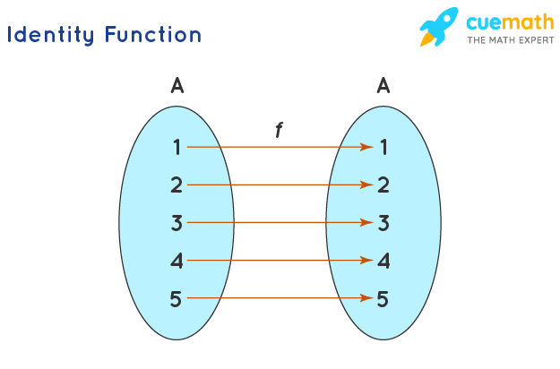
Identity function
The identity function is a function on A
A function is considered to be an identity function when it returns the same value as the output that was used as its input.
Denoted 1_{A} Defined by 1_{A}(a) = a
1_{A} is represented as a subset of A × A with the identity matrix

Slide 13
Example 5: If g(y) = (2y+3)/(3y-2). Then prove that g ◦ g is an identity function.
Solution:
g(y) = (2y+3)/(3y-2)
g ◦ g(y) = g(g(y)) = g((2y+3)/(3y-2))
= substitute g(y) in itself
= 13y/13
= y
Answer: g ◦ g(y) = y. Thus, g ◦ g(y) is an identity function

Slide 14
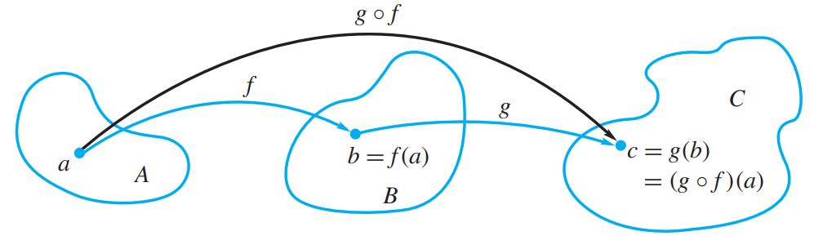
Composition
If f: A → B and g: B → C, then the composition of f and g, g ° f, is a relation.
Let a ∈ Dom(g ° f).
(g ° f )(a) = g(f(a))
If f(a) maps to exactly one element, say b ∈ B, then g(f(a)) = g(b)
If g(b) also maps to exactly one element, say c ∈ C, then g(f(a)) = c
Thus for each a ∈ A, (g ° f )(a) maps to exactly one element of C and g ° f is a function

Slide 15
Example6 Let A = B = Z, and C be the set of even integers.
Let f : A → B and g : B → C be defined by f (a) = a + 1, g(b) = 2b.
Find g ◦ f .
Solution:
We have
(g ◦ f )(a) = g( f (a)) = g(a + 1) = 2(a + 1).
Thus, if f and g are functions specified by giving formulas, then so is g◦ f and the
formula for g ◦ f is produced by substituting the formula for f into the formula
for g

Slide 16
Special types of functions
f is “everywhere defined” if Dom(f) = A Injective
f is “onto” if Ran(f) = B Surjective
f is “one-to-one” if it is impossible to have f(a) = f(a') if a ≠ a', i.e., if f(a) = f(a'), then a = a’
A function is said to be bijective or bijection if a function f: A → B satisfies both the injective (one-to-one function)
f: A → B is “invertible” if its inverse function f ⁻¹ is also a function. (Note, f ⁻¹ is simply the reversing of the ordered pairs)

Slide 17
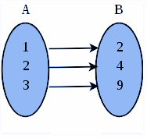
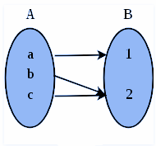
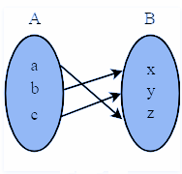
Injective Function | Surjective Function | Bijective Function
A function that always maps the distinct element of its domain to the distinct element of its codomain | A function that maps one or more elements of A to the same element of B | A function that is both injective and surjective
It is also known as one-to-one function | It is also known as onto function | It is also known as one-to-one correspondence

Slide 18
Example7 : Let A = {a1, a2, a3}, B = {b1, b2, b3}, C = {c1, c2}, and D = {d1, d2, d3, d4}.
Consider the following four functions, from A to B, A to D, B to C, and D to B,
respectively.
(a) f1 = {(a1, b2), (a2, b3), (a3, b1)}
(b) f2 = {(a1, d2), (a2, d1), (a3, d4)}
(c) f3 = {(b1, c2), (b2, c2), (b3, c1)}
(d) f4 = {(d1, b1), (d2, b2), (d3, b1)}
Determine whether each function is one to one, whether each function is onto, and
whether each function is everywhere defined.
Solution
(a) f1 is everywhere defined, one to one, and onto.
(b) f2 is everywhere defined and one to one, but not onto.
(c) f3 is everywhere defined and onto, but is not one to one.
(d) f4 is not everywhere defined, not one to one, and not onto.

Slide 19
Bijective Function:
If f: A → B is a one-to-one function, then f assigns to each element a of Dom( f ) an element b = f (a) of Ran( f ). Every b in Ran( f ) is matched, in this way, with one and only one element of Dom( f ).
For this reason, such an f is often called a bijection between Dom( f ) and Ran( f ).
If f is also everywhere defined and onto, then f is called a one-to-one correspondence between A and B

Slide 20
Invertible Functions
A function f : A → B is said to be invertible if its inverse relation, f −1, is also a function.
Using Example 1 Let A = {1, 2, 3, 4} and B = {a, b, c, d}, and let
f = {(1, a), (2, a), (3, d), (4, c)}.
Then f⁻¹ = {(a, 1), (a, 2), (d, 3), (c, 4)}.
We see that f⁻¹ is not a function, since f⁻¹ (a) = {1, 2}.
Example8: Let R be the set of real numbers, and let f: R → R be defined by f (x) = X². Is f invertible?
Solution: We must determine whether f is one-to-one. Since f (2) = f (−2) = 4,
we conclude that f is not one-to-one. Hence f is not invertible.

Slide 21
Bijective Function Example : skip
Show that the function f(x) = 3x – 5 is a bijective function from R to R.
Solution:
Given Function: f(x) = 3x – 5
To prove: The function is bijective.
According to the definition of the bijection, the given function should be both injective and surjective.
(i) To Prove: The function is injective
In order to prove that, we must prove that f(a)=c and f(b)=c then a=b.
Let us take, f(a)=c and f(b)=c
Therefore, it can be written as: c = 3a-5 and c = 3b-5
Thus, it can be written as: 3a-5 = 3b -5
Simplify the equation; we will get a = b
Thus, the given function is injective
(ii) To Prove: The function is surjective
To prove this case, first, we should prove that that for any point “a” in the range there exists a point “b” in the domain s, such that f(b) =a
Let, a = 3x -5
Therefore, b must be (a+5)/3
Since this is a real number, and it is in the domain, the function is surjective.
Thus, the given function satisfies the condition of one-to-one function, and onto function, the given function is bijective.
Hence, proved.

Slide 22
Theorems of Functions
Let f: A→ B be a function; f ⁻¹ is a function from B to A if and only if f is one-to-one
If f ⁻¹ is a function, then
the function f ⁻¹ is also one-to-one
f ⁻¹ is everywhere defined if and only if f is onto
f ⁻¹ is onto if and only if f is everywhere defined

Slide 23
Another Theorem of Functions
If f is everywhere defined, one-to-one, and onto, then f is a one-to-one correspondence between A & B.
Thus f is invertible and f ⁻¹ is a one-to-one correspondence between B & A.

Slide 24
More Theorems of Functions concerning the composition of functions
Let f be any function:
1_{B} ° f = f
f ° 1_{A} = f
If f is a one-to-one correspondence between A and B, then
f ⁻¹ ° f = 1_{A}
f ° f ⁻¹ = 1_{B}
Let f: A → B and g: B → C be invertible.
(g ° f) is invertible
(g ° f)⁻¹ = (f ⁻¹ ° g ⁻¹)

Slide 25
Solve:
f(x) = 2.x +3 check if it is onto
If f(x)=13.x – 5 is bijective what is inverse of f(x) ……..(x+5)/13
Find composition of following
f : R → R f(x) 2+3x
g: g(x)= 4-2x, h: h(x)= (square(x) +1)
G o f = ? ; h o f =?

Slide 26
Pigeonhole Principle
The Pigeonhole Principle can be formally stated as follows:
If n items are distributed among m containers and n > m, then at least one container must contain more than one item.
The pigeonhole principle is useful in counting methods. In order to apply the principle, one has to decide which objects will play the role of pigeon and which objects will play the role of pigeonholes.
The Pigeonhole Principle is a simple yet powerful combinatorics tool used to solve a variety of problems. Its applications extend to probability, set theory, and beyond.
Statement | If there are more pigeons than holes, at least one hole will contain more than one pigeon
Extended statement | If there are more pigeons than holes multiplied by an integer, at least one hole will contain more than that integer number of pigeons

Slide 27
Pigeonhole Principle Theorem
We can say that, if n + 1 objects are put into n boxes, then at least one box contains two or more objects.
The abstract formulation of the principle: Let X and Y be finite sets and let f: A→B be a function.
If X has more elements than Y, then f is not one-to-one.
If X and Y have the same number of elements and f is onto, then f is one-to-one.
If X and Y have the same number of elements and f is one-to-one, then f is onto.
Example 9: If (Kn+1) pigeons are kept in n pigeon holes where K is a positive integer, what is the average no. of pigeons per pigeon hole?
Solution:
Average number of pigeons per hole = (Kn+1)/n = K + 1/n
Therefore there will be at least one pigeonhole which will contain at least (K+1) pigeons i.e., ceil[K +1/n] and remaining will contain at most K i.e., floor[k+1/n] pigeons. i.e., the minimum number of pigeons required to ensure that at least one pigeon hole contains (K+1) pigeons is (Kn+1).

Slide 28
Example 10: A bag contains 10 red marbles, 10 white marbles, and 10 blue marbles. What is the minimum no. of marbles you have to choose randomly from the bag to ensure that we get 4 marbles of same color?
Solution:
Apply pigeonhole principle.
No. of colors (pigeonholes) n = 3
No. of marbles (pigeons) K+1 = 4
Therefore the minimum no. of marbles required = Kn+1
By simplifying we get Kn+1 = 10.
Verification: ceil[Average] is [Kn+1/n] = 4 [Kn+1/3] = 4 Kn+1 = 10 i.e., 3 red + 3 white + 3 blue + 1(red or white or blue) = 10

